Slide 1
Unit 13
Neural Networks and Time Series

Slide 2
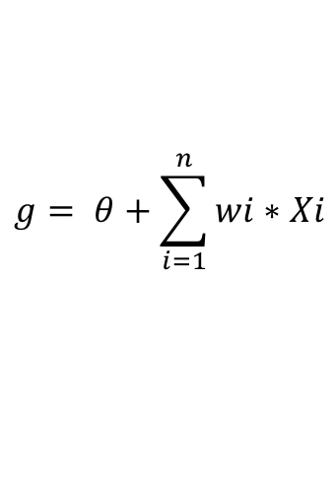
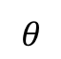
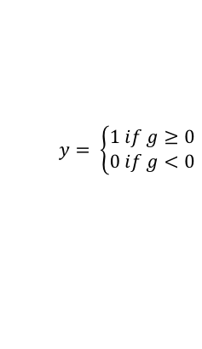
The Perceptron
Input Layer
Output Layer
X1
1
$$θ$$
w₁
X2
2
w₂
$$g= θ+\sum_{i=1}^{n}{wi∗Xi}$$
y
…
$$y= \left\{\begin{aligned}1 if g≥0 \\ 0 if g<0\end{aligned}\right.$$
w_{n}
Other activation functions
Xn
n

Slide 3
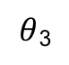
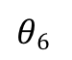
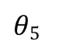
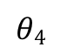
Multilayered Perceptron (MLP) (The Neural Network Model)
Hidden Layer
Input Layer
Output Layer
$θ$₃
3
w₁₃
X1
1
AF
w₃₆
$$θ6$$
w₁₄
$$θ4$$
4
w₄₆
6
w₂₃
y
w₁₅
w₂₄
AF
AF
X2
2
$$θ5$$
w₅₆
w₂₅
Activation Function
5
AF

Slide 4
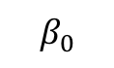
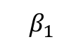
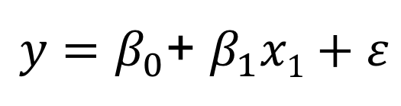
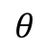
A Familiar Neural Network: SLR
$y=β_{0}$+ $β_{1}x1+ε$
Hidden Layer
Input Layer
Output Layer
$$β_{0}$$
$$θ$$
1
$$β_{1}$$
6
w₄₆
X₁
y
AF
Linear Activation Function
(Identity, Same as no activation function.)

Slide 5
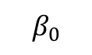
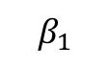
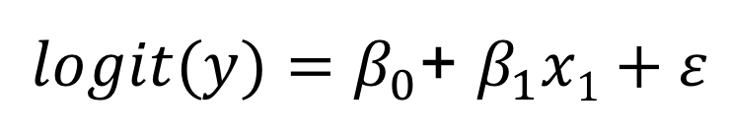
Another Familiar Neural Network
Hidden Layer
Input Layer
Output Layer
$logit(y)=β_{0}$+ $β_{1}x1+ε$
$$β_{0}$$
1
$$β_{1}$$
6
X₁
y
Logistic Activation Function

Slide 6
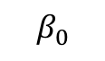
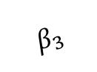
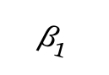
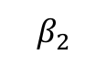
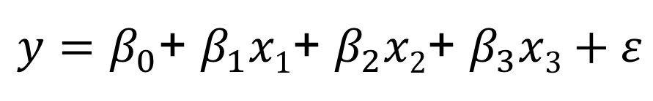
MLR as a Neural Network: MLR
$y=β_{0}$+ $β_{1}x1\text{+ }β_{2}x\text{2}\text{+ }β_{3}x3+ε$
Input Layer
Hidden Layer
Output Layer
1
X₁
$$β_{1}$$
$$β_{0}$$
2
6
$$β_{2}$$
X₂
y
$$β_{3}$$
3
Linear Activation Function
X₃

Slide 7
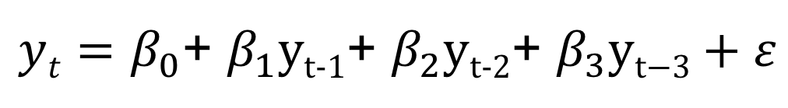
Time Series as a Neural Network: AR(3)
$yt=β_{0}$+ $β_{1}\text{y}\text{t}\text{−1}\text{+ }β_{2}\text{y}\text{t}\text{−2}\text{+ }β_{3}\text{y}\text{t}\text{−}3+ε$
Input Layer
Output Layer
1
y_{t-1}
$$β_{1}$$
$$β_{0}$$
2
6
$$β_{2}$$
y_{t-2}
y_{t}
$$β_{3}$$
3
Linear Activation Function
y_{t-3}

Slide 8
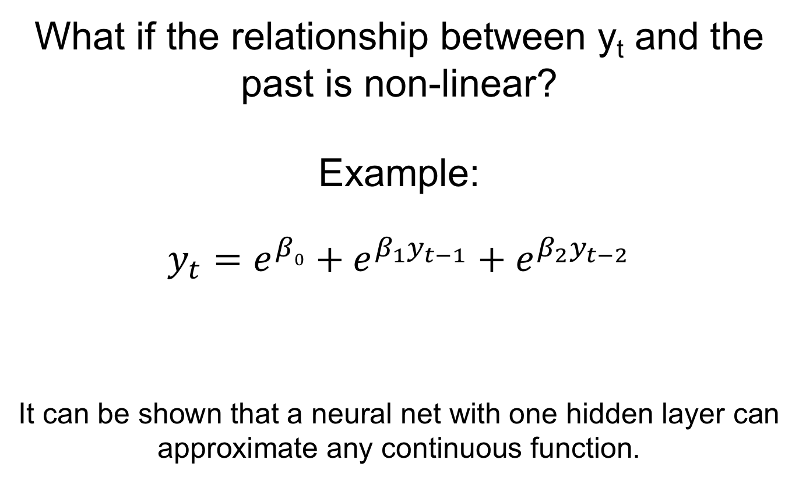
What if?
What if the relationship between y_{t} and the past is non-linear?
Example:
$$y_{t}=e^{β0}+e^{β_{1}y_{t−1}}+e^{β_{2}y_{t−2}}$$
It can be shown that a neural net with one hidden layer can approximate any continuous function.

Slide 9
Multilayered Perceptron (MLP) (The Neural Network Model)
Hidden Layer
Input Layer
Output Layer
$θ$₃
3
w₁₃
y_{t-1}
1
AF
w₃₆
$$θ6$$
w₁₄
$$θ4$$
4
w₄₆
6
w₂₃
y_{t}
w₁₅
w₂₄
AF
AF
y_{t-2}
2
$$θ5$$
w₅₆
w₂₅
Activation Function
5
AF

Slide 11
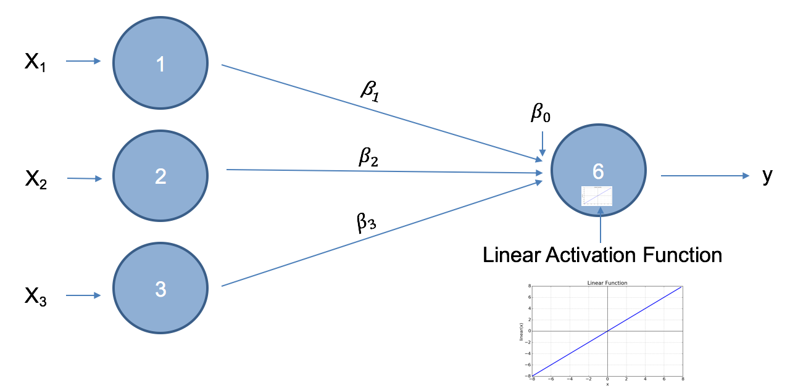
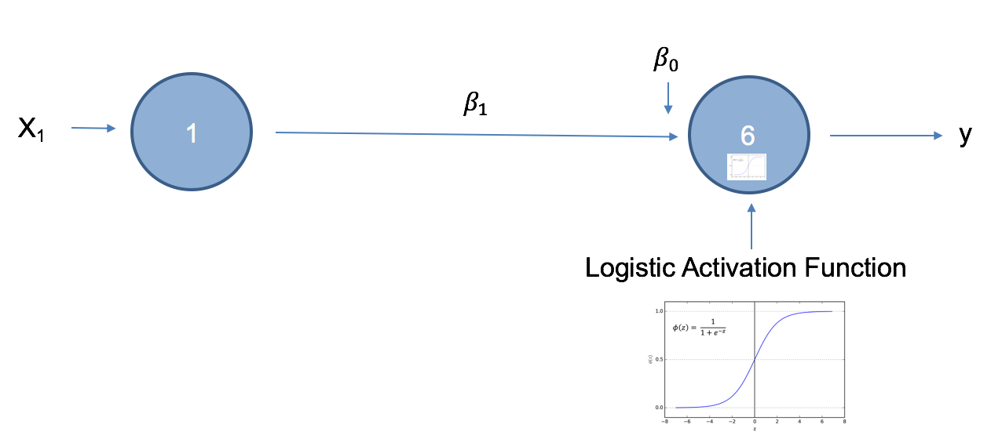

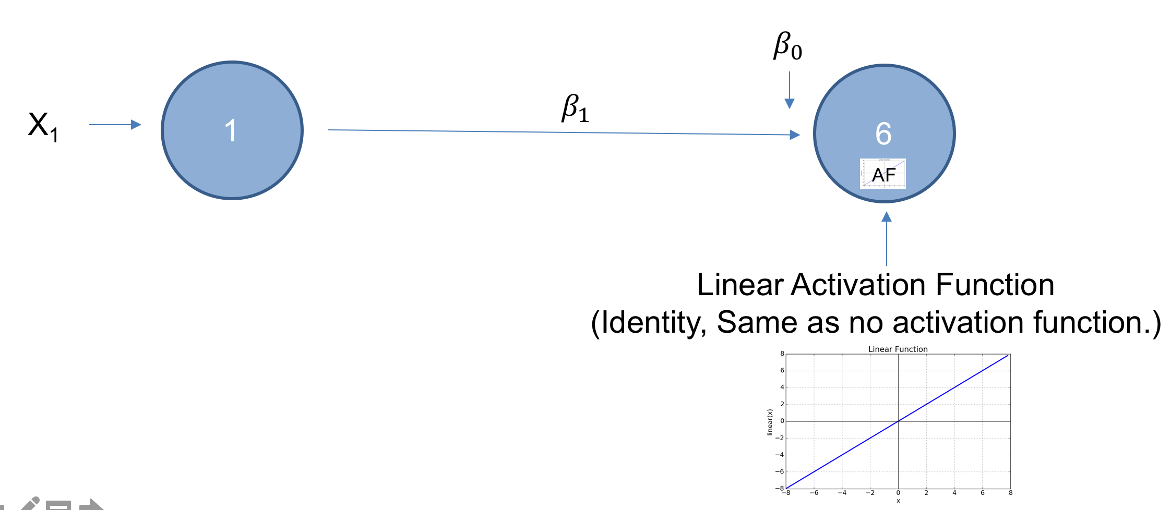
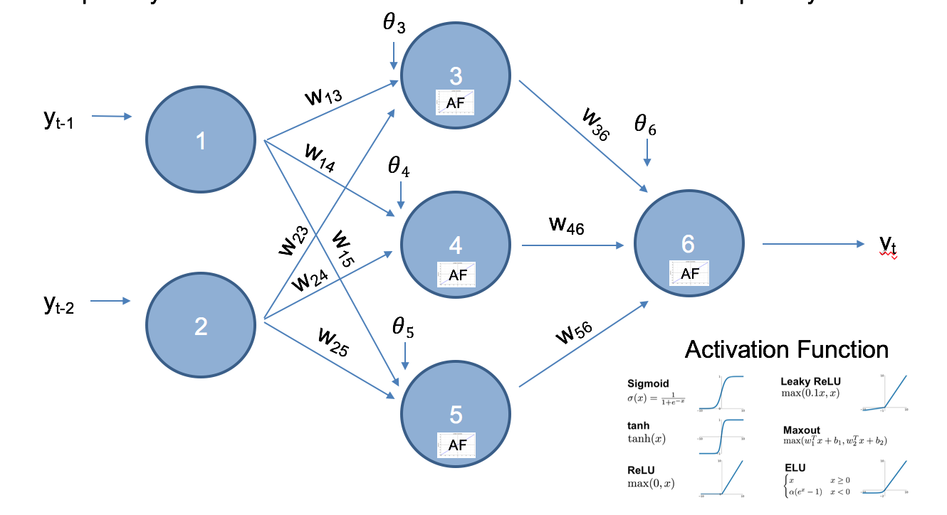
Concept Check
Match the model with the appropriate neural network:
A
C
1. Simple Linear Regression Model
2. AR(3)
3. Multiple Linear Regression Model
4. Non-linear model
5. Log linear model.
B
D
E

Slide 12
Concept Check
Match the model with the appropriate neural network:
A
C
B
D
1. Simple Linear Regression Model D
2. AR(3)B
3. Multiple Linear Regression Model A
4. Non-linear model E
5. Log linear model. C
E

Slide 13
Concept Check
2. True / False: The input nodes have activation functions.
3. TRUE / FALSE: Adding 1 or more “hidden layers” allows for estimation of non-linear relationships between the inputs and the outputs.
4. TRUE / FALSE A single Hidden Layer can approximate any continuous function (model).
5. TRUE / FALSE: Gradient decent is the only option for estimating the weights and biases.

Slide 14
Concept Check
2. True / False: The input nodes have activation functions.
3. TRUE / FALSE: Adding 1 or more “hidden layers” allows for estimation of non-linear relationships between the inputs and the outputs.
4. TRUE / FALSE A single Hidden Layer can approximate any continuous function (model).
5. TRUE / FALSE: Gradient decent is the only option for estimating the weights and biases.

Slide 16
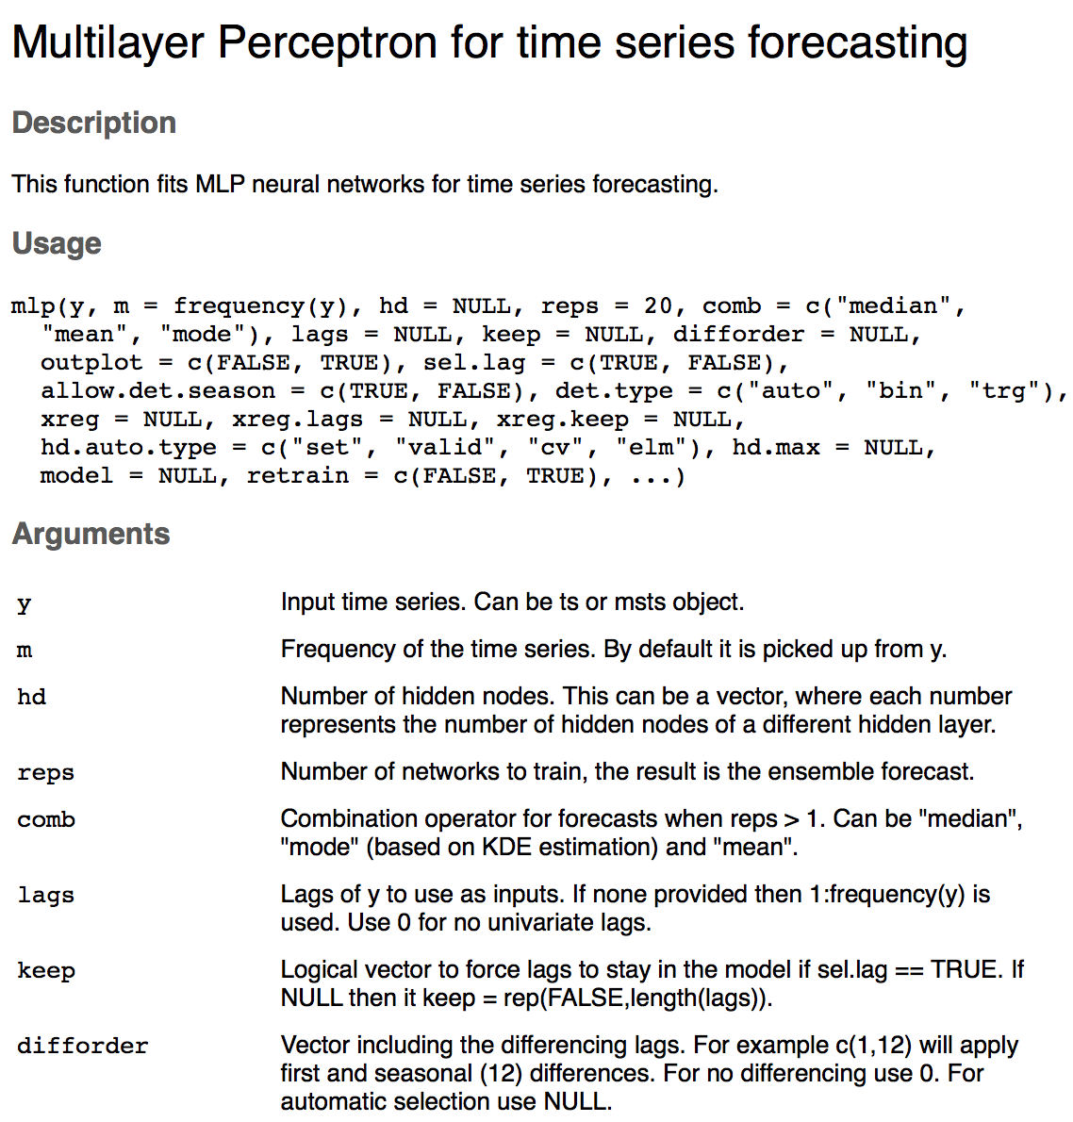
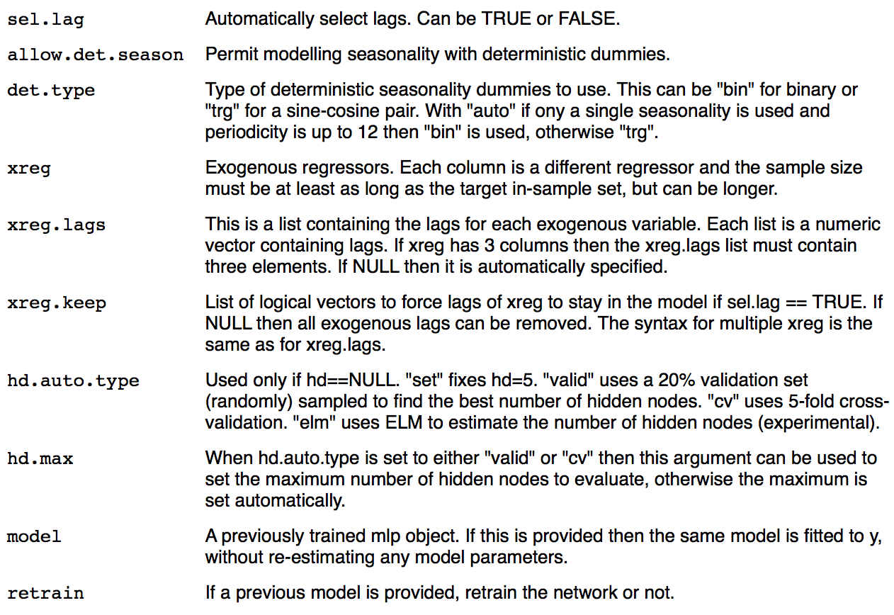
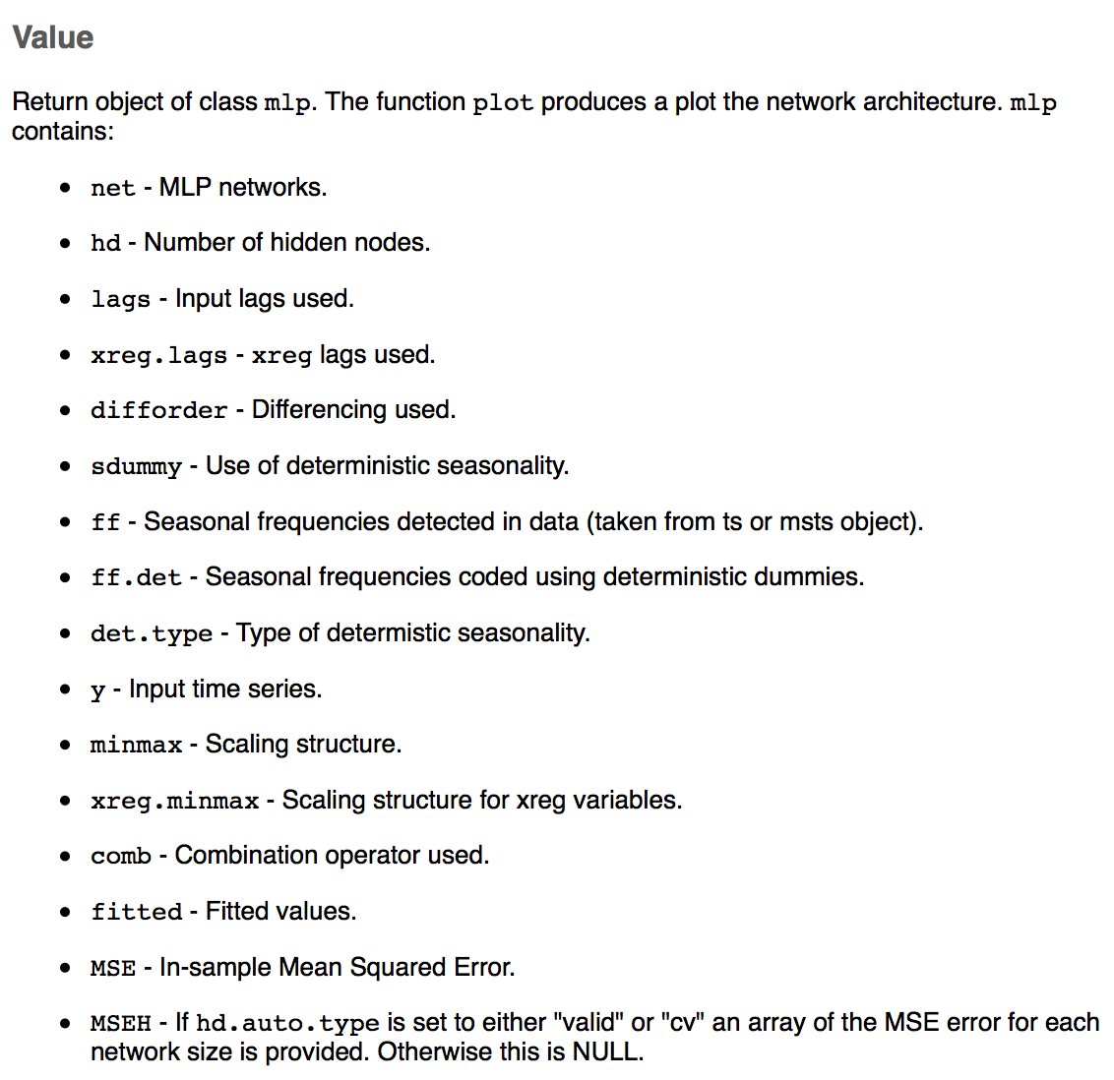
MLPs and R
mlp {nnfor}

Slide 17
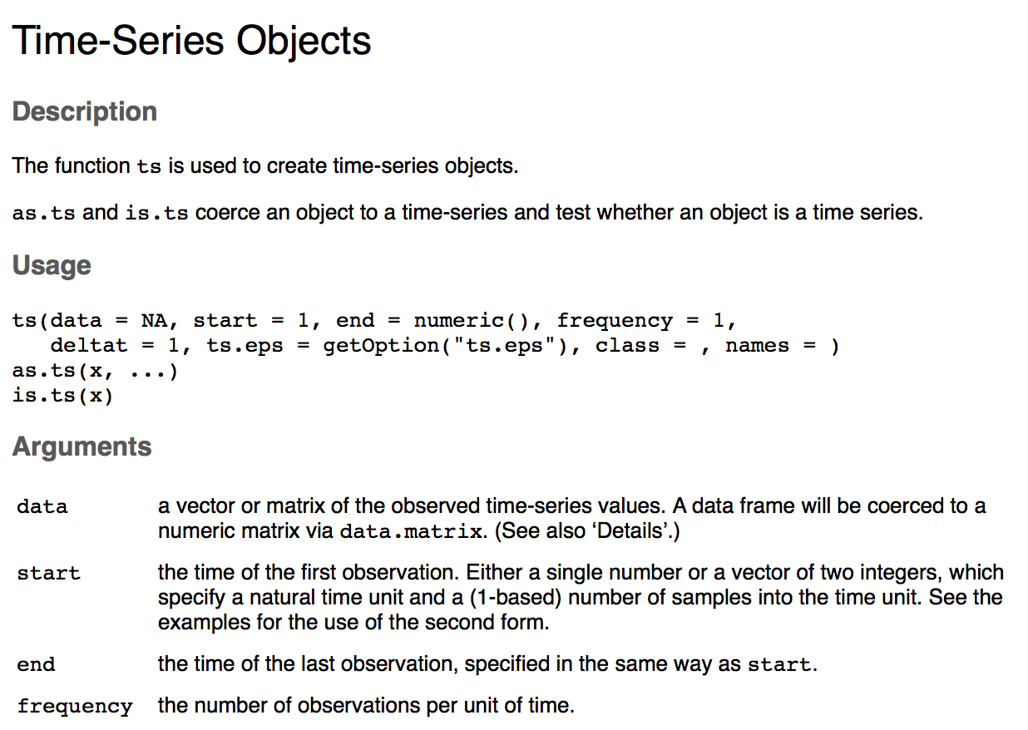
Example: SWA Delays
SWATrain = ts(SWA$arr_delay[1:141],start=c(2004,1),frequency = 12)

Slide 18
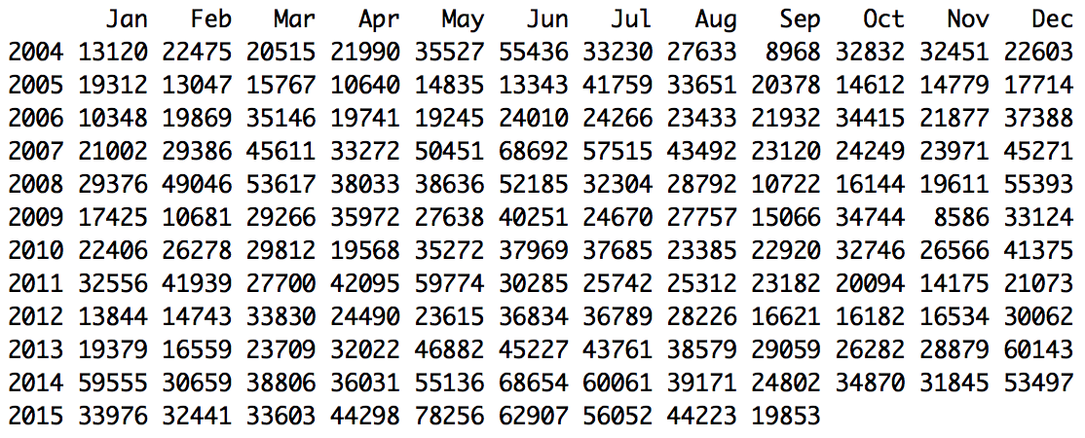
Example: SWA Delays
SWATrain = ts(SWA$arr_delay[1:141],start=c(2004,1),frequency = 12)

Slide 20
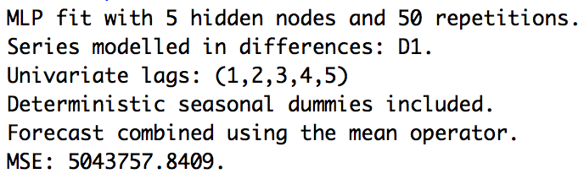
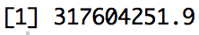
Example: SWA Delays
#Divide dataset into training and test set. The last 36 months in the test set.
SWATrain = ts(SWA$arr_delay[1:141],start= c(2004,1),frequency = 12)
SWATest = ts(SWA$arr_delay[142:177],start = c(2015,10),frequency = 12)
set.seed(2)
fit.mlp = mlp(SWATrain,reps = 50,comb = "mean")
fit.mlp
fore.mlp = forecast(fit.mlp, h = 36)
plot(fore.mlp)
# Visualize the Neural Network
plot(fit.mlp)
ASE = mean((SWATest - fore.mlp$mean)^2)
ASE
Note: pink nodes are for seasonal dummies and grey nodes are for lagged inputs

Slide 21
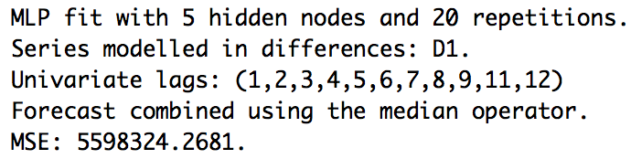
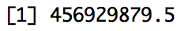
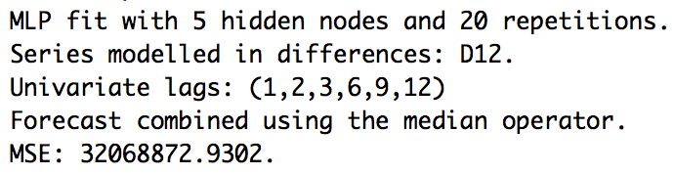
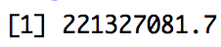
Example: SWA Delays
fit.mlp = mlp(SWATrain, lags = c(1,2,3,4,5,6,7,8,9,10,11,12), allow.det.season = FALSE)
set.seed(2)
fit.mlp
plot(fit.mlp)
fore.mlp = forecast(fit.mlp, h = 36)
plot(fore.mlp)
ASE = mean((SWATest - fore.mlp$mean)^2)
ASE
fit.mlp = mlp(SWATrain, difforder = c(12), allow.det.season = FALSE)
set.seed(2)
fit.mlp
plot(fit.mlp)
fore.mlp = forecast(fit.mlp, h = 36)
plot(fore.mlp)
ASE = mean((SWATest - fore.mlp$mean)^2)
ASE

Slide 22
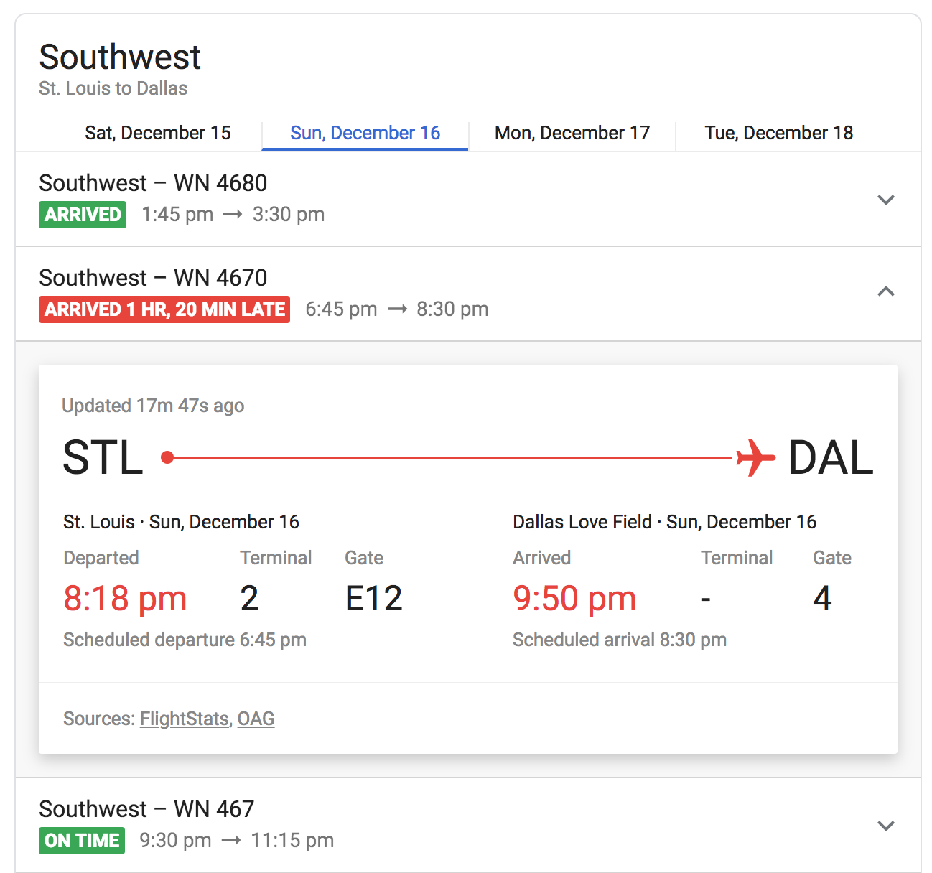
Example: SWA Delays
Model: AR(12):
(1-0.44B- 0.02B² +0.12B³ -0.08B⁴ +0.00B⁵ -0.02B⁶ -0.06B⁷ +0.09B⁸ -0.06B⁹ -0.07B¹⁰ -0.02B¹¹ -0.37B¹²)(X_{t} – 34934) = a_{t}
f = fore.arma.wge(SWA$arr_delay,phi = c(0.44, 0.02, -0.12, 0.08, 0.00, 0.02, 0.06, -0.09, 0.06, 0.07, 0.02, 0.37), n.ahead = 30, lastn = TRUE,limits = FALSE)
ASE = mean((SWA$arr_delay[148:177]- f$f)^2)
ASE
ASE: 309880104

Slide 23
Example: SWA Delays
$$φ_{13}\left(1−B^{12}\right)X_{t}=a_{t}$$
#Factor Table suggested s = 12
SWA.12 = artrans.wge(SWA$arr_delay[1:141],c(rep(0,11),1))
p = aic5.wge(SWA.12,p = 0:18, q = 0:2)
#AIC picks p = 13
AR13 = est.arma.wge(SWA.12,p = 13)
f = fore.aruma.wge(SWA$arr_delay,phi = AR13$phi, s = 12, n.ahead = 36, lastn = TRUE)
ASE = mean((SWA$arr_delay[142:177] - f$f)^2)
ASE
ASE: 215312956

Slide 24


SWA Delay Comarison
AR(12)
$$φ_{13}\left(1−B^{12}\right)X_{t}=a_{t}$$
$$Best NN$$
ASE: 309880104
ASE: 215312956
ASE: 2213 27081.7
The seasonal ARIMA model performed best in terms of ASE in this analysis although all are very close and leaders could easily change if the horizon was changed, another sample was taken or if a different number of repeats is used in the NN.

Slide 26
Concept Check
Inspect the spectral density estimate of the Southwest airlines arrival delay data from the last example below. There appears to be some evidence of a peak at 0, around .08 and around .16. This would correspond to wandering behavior, annual period and bi-annual behavior. Which r call below fits 100 neural networks that includes a (1-B), (1-B⁶) and (1-B¹²) seasonal factor and also allows for AR fitting of the residuals after the differencing?
A. fit.mlp = mlp(SWATrain, difforder = 0, lags = c(1,6,12), allow.det.season = FALSE, reps = 100)
B. fit.mlp = mlp(SWATrain, difforder = c(1,6,12), allow.det.season = FALSE, reps = 100)
C. fit.mlp = mlp(SWATrain, difforder = c(1,6,12), lags = 0, allow.det.season = FALSE, reps = 100)

Slide 27
Concept Check
Inspect the spectral density estimate of the Southwest airlines arrival delay data from the last example below. There appears to be some evidence of a peak at 0, around .08 and around .16. This would correspond to wandering behavior, annual period and bi-annual behavior. Which r call below fits 100 neural networks that includes a (1-B), (1-B⁶) and (1-B¹²) seasonal factor and also allows for AR fitting of the residuals after the differencing?
A. fit.mlp = mlp(SWATrain, difforder = 0, lags = c(1,6,12), allow.det.season = FALSE, reps = 100)
B. fit.mlp = mlp(SWATrain, difforder = c(1,6,12), allow.det.season = FALSE, reps = 100)
C. fit.mlp = mlp(SWATrain, difforder = c(1,6,12), lags = 0, allow.det.season = FALSE, reps = 100)

Slide 28
Concept Check
Given that the R code below will fit 100 neural networks that include a (1-B), (1-B⁶) and (1-B¹²) seasonal factor and also allows for AR fitting of the residuals after the differencing, use this code to obtain forecasts of the number of delays in the last 36 months (from October, 2015, to September, 2018.)
fit.mlp = mlp(SWATrain, difforder = c(1,6,12), allow.det.season = FALSE, reps = 100)
1. Does this model have a lower ASE than then the lowest ASE of the neural nets we fit in the example? (200083263.2) YES NO
Does this model have a lower ASE than then the lowest ASE of the AR(12) model we fit in a previous unit? (93354237) YES NO
3. Fit the model and find the ASE and display it in a comment below. Everyone’s ASE should be different. Why?

Slide 29
Concept Check
Given that the R code below will fit 100 neural networks that include a (1-B), (1-B⁶) and (1-B¹²) seasonal factor and also allows for AR fitting of the residuals after the differencing, use this code to obtain forecasts of the number of delays in the last 36 months (from October, 2015, to September, 2018.)
fit.mlp = mlp(SWATrain, difforder = c(1,6,12), allow.det.season = FALSE, reps = 100)
1. Does this model have a lower ASE than then the lowest ASE of the neural nets we fit in the example? (200083263.2) YES NO
Does this model have a lower ASE than then the lowest ASE of the AR(12) model we fit in a previous unit? (93354237) YES NO
3. Fit the model and find the ASE and display it in a comment below. Everyone’s ASE should be different. Why? Answer will vary.

Slide 31
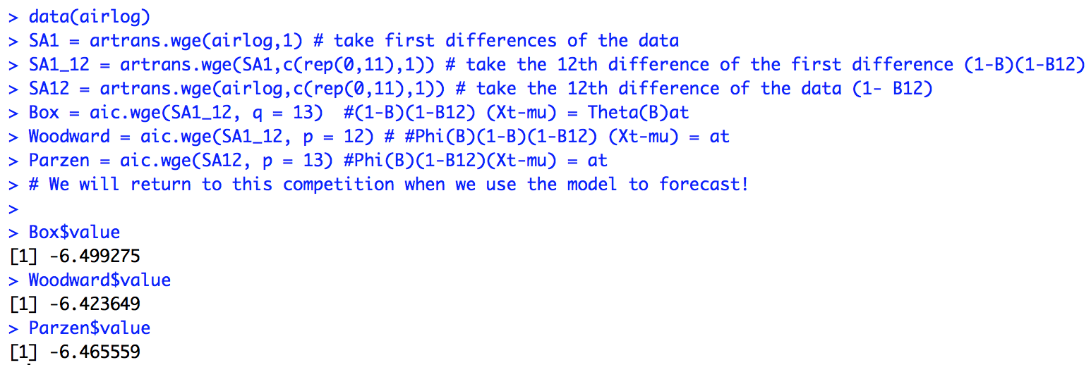
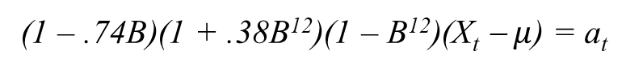
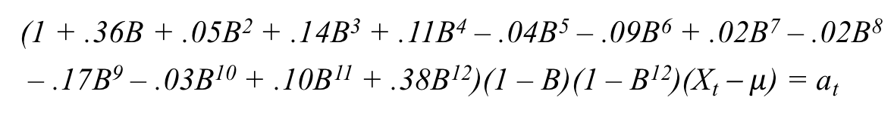
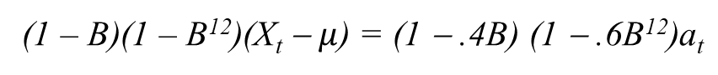
Airline Competition Among the Greats!
Now we will compare the actual models they published on the basis of the ASE calculated from forecasts of the last 36 years.
AIC
(1 – .74B)(1 + .38B¹²)(1 – B¹²)(X_{t} − $μ$) = a_{t}
(1 – B)(1 – B¹²)(X_{t} − $μ$) = (1 − .4B) (1 − .6B¹²)a_{t}
(1 + .36B + .05B² + .14B³ + .11B⁴ – .04B⁵ – .09B⁶ + .02B⁷ – .02B⁸
– .17B⁹ – .03B¹⁰ + .10B¹¹ + .38B¹²)(1 – B)(1 – B¹²)(X_{t} − $μ$) = a_{t}
Box = fore.aruma.wge(airlog,d = 1, s = 12, theta = c(.4,0,0,0,0,0,0,0,0,0,0,.6,-.24),n.ahead = 36,lastn = TRUE, limits = FALSE)
BOX_ASE = mean((airlog[(144-36+1):144] - Box$f)^2)
BOX_ASE
Woodward = fore.aruma.wge(airlog,d = 1, s = 12, phi = c(-.36,-.05,-.14,-.11,.04,.09,-.02, .02,.17,.03,-.10,-.38),n.ahead = 36,lastn = TRUE, limits = FALSE)
WOODWARD_ASE = mean((airlog[(144-36+1):144] - Woodward$f)^2)
WOODWARD_ASE
Parzen = fore.aruma.wge(airlog, d = 0, s = 12, phi = c(.74,0,0,0,0,0,0,0,0,0,0,.38,-.2812),n.ahead = 36,lastn = TRUE, limits = FALSE)
PARZEN_ASE = mean((airlog[(144-36+1):144] - Parzen$f)^2)
PARZEN_ASE

Slide 32
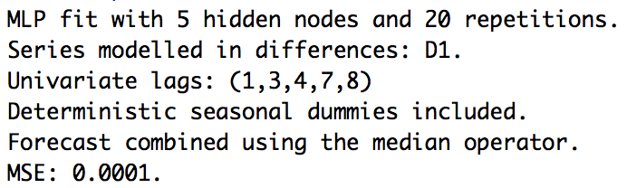
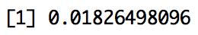
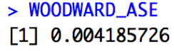
Example: Airline Data
# First 108 months in the Training Set.
set.seed(2)
lairTrain = ts(airlog[1:108], frequency = 12, start = c(1949, 1))
# Last 36 months in the Test set.
lairTest = ts(airlog[109:144], frequency = 12, start = c(1958, 1))
fit.mlp = mlp(lairTrain)
fit.mlp
plot(fit.mlp)
fore.mlp = forecast(fit.mlp, h = 36)
plot(fore.mlp)
ASE = mean((lairTest - fore.mlp$mean)^2)
ASE

Slide 34
Concept Check
We know that mlp() uses 5 hidden nodes by default, but can we do better at forecasting sales with more or less? hd.auto.type is an option in the mlp() function that can select the number of hidden nodes for you. Read the help for mlp() (?mlp) and see what the options are are for this option. We would like to forecast the last 36 observations of the log airline passengers like we did before but this time automatically select the number of hidden nodes with 5 fold cross validation. Use set.seed(2) at the beginning of the code so that we get the same answers.
Did it take longer to run than without the hd.auto.type call? YES NO
2. How many hidden nodes were selected by hd.auto.type?
3. What is the ASE for this model?

Slide 35
Concept Check
We know that mlp() uses 5 hidden nodes by default, but can we do better at forecasting sales with more or less? hd.auto.type is an option in the mlp() function that can select the number of hidden nodes for you. Read the help for mlp() (?mlp) and see what the options are are for this option. We would like to forecast the last 36 observations of the log airline passengers like we did before but this time automatically select the number of hidden nodes with 5 fold cross validation. Use set.seed(2) at the beginning of the code so that we get the same answers.
Did it take longer to run than without the hd.auto.type call? YES NO
2. How many hidden nodes were selected by hd.auto.type? 2
3. What is the ASE for this model? .017
set.seed(2)
lairTrain = ts(airlog[1:108], frequency = 12, start = c(1949, 1))
# Last 36 months in the Test set.
lairTest = ts(airlog[109:144], frequency = 12, start = c(1958, 1))
fit.mlp = mlp(lairTrain, hd.auto.type = "cv")

Slide 37
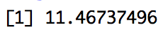
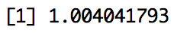
Example: Multivariate NNs with the Sales Data
#BS is the Business data
# Only Time as a regressor
tBS80 = ts(BS$sales[1:80])
set.seed(2)
fit3 = mlp(tBS80)
f = forecast(fit3, h = 20)
plot(BS$sales[81:100],type = "l")
lines(seq(1,20),f$mean, col = "blue")
ASE = mean((BS$sales[81:100]-f$mean)^2)
ASE
#With additional Regressors
set.seed(2)
tBS80 = ts(BS$sales[1:80])
tBSx = data.frame(ad_tv = ts(BS$ad_tv), ad_online = ts(BS$ad_online, frequency = 7),discount = ts(BS$discount))
fit3 = mlp(tBS80,xreg = tBSx)
f = forecast(fit3, h = 20, xreg = tBSx)
plot(BS$sales[81:100],type = "l")
lines(seq(1,20),f$mean, col = "blue")
ASE = mean((BS$sales[81:100]-f$mean)^2)
ASE

Slide 38
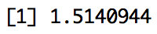
Example: Multivariate NNs with the Sales Data
#ARIMA Model with Regressors
ad_tv1 = c(NA,BS$ad_tv[1:(length(BS$ad_tv)-1)])
ad_online1 = c(NA,BS$ad_online[1:(length(BS$ad_online)-1)])
BS$ad_tv1= ad_tv1
BS$ad_online1 = ad_online1
ksfit=lm(sales~ad_tv1+ad_online1+discount, data = BS)
aic.wge(ksfit$residuals,p=0:8,q=0:0) # AIC picks p=7
fit=arima(BS$sales,order=c(7,0,0),xreg=cbind(BS$ad_tv1, BS$ad_online1, BS$discount))
preds = forecast(fit,h = 20, xreg = cbind(BS$ad_tv1[81:100],BS$ad_online1[81:100],BS$discount[81:100]))
plot(BS$sales[81:100],type = "l")
lines(seq(1,20),preds$mean, col = "blue")
ASE = mean((BS$sales[81:100]-preds$mean)^2)
ASE
#NN With additional Regressors
set.seed(2)
tBS80 = ts(BS$sales[1:80])
tBSx = data.frame(ad_tv = ts(BS$ad_tv), ad_online = ts(BS$ad_online, frequency = 7),discount = ts(BS$discount))
fit3 = mlp(tBS80,xreg = tBSx)
f = forecast(fit3, h = 20, xreg = tBSx)
plot(BS$sales[81:100],type = "l")
lines(seq(1,20),f$mean, col = "blue")
ASE = mean((BS$sales[81:100]-f$mean)^2)
ASE

Slide 40
Concept Check:
We would like to now forecast the sales data with the 3 regressors (ad_tv, ad_online and discount) but this time automatically select the number of hidden nodes with 5 fold cross validation. Remember to use set.seed(2) so that our answers match!
How many nodes were selected by hd.auto.type?
What was the corresponding ASE? (Round to 3 decimal places)

Slide 41
Concept Check:
We would like to now forecast the sales data with the 3 regressors (ad_tv, ad_online and discount) but this time automatically select the number of hidden nodes with 5 fold cross validation. Remember to use set.seed(2) so that our answers match!
How many nodes were selected by hd.auto.type?
What was the corresponding ASE? (Round to 3 decimal places)
1
.736

Slide 43
Interview with Mikio Braun

Slide 45
For Live Session
Schumway Data
Sunspot / Melanoma Data
SWA DELAY DATA
Recurrent NN

Slide 47
Closing Remarks

Slide 49
RNN and LSTMs
Josh Gordon (Google Tensorflow Dev)
“About half of your life when you are developing networks is spent understanding the data type and the shapes of the data that you are trying to work with.”
“A Tensor is just an n-dimensional array … so you can think of Tensorflow as Arrayflow… that’s all it is."

